Slide 1
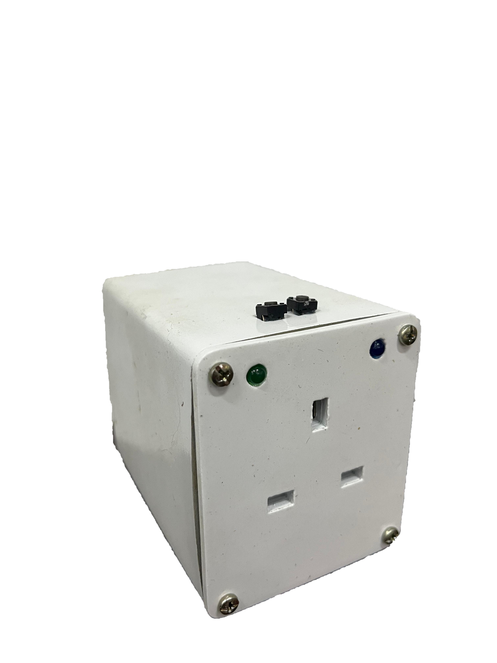
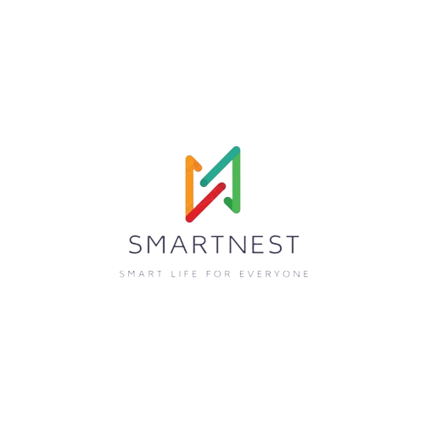
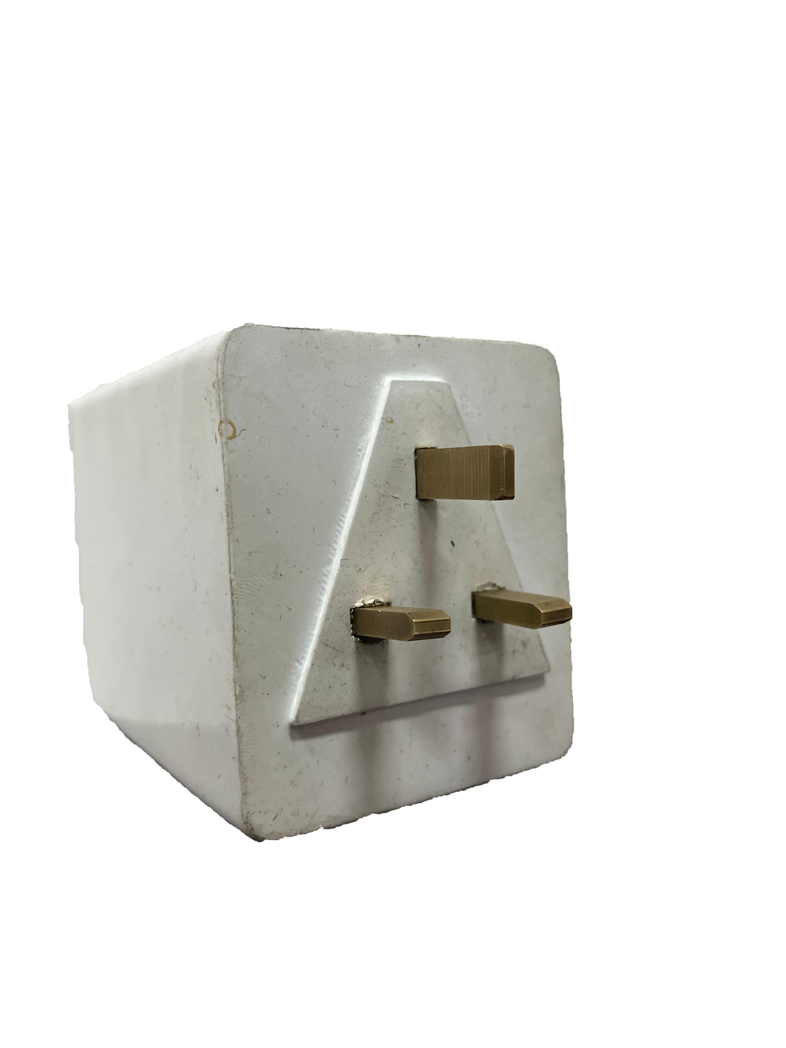
An Invitation to the Future
SMARTSOCKET
20A
Today, we'll unveil our innovative smart socket that brings conveniences, and more, to your fingertips!"
Innovative & Collaborative

Slide 2

Product Launch Presentation
OUR TEAM
S.J SIRIWARDANE E/19/377
M.G.S.U MAHANAMA E/19/233
M.W.R.N MARAPANA E/19/237
K.T.M.L.S SERASINGHE E/19/367
01

Slide 3
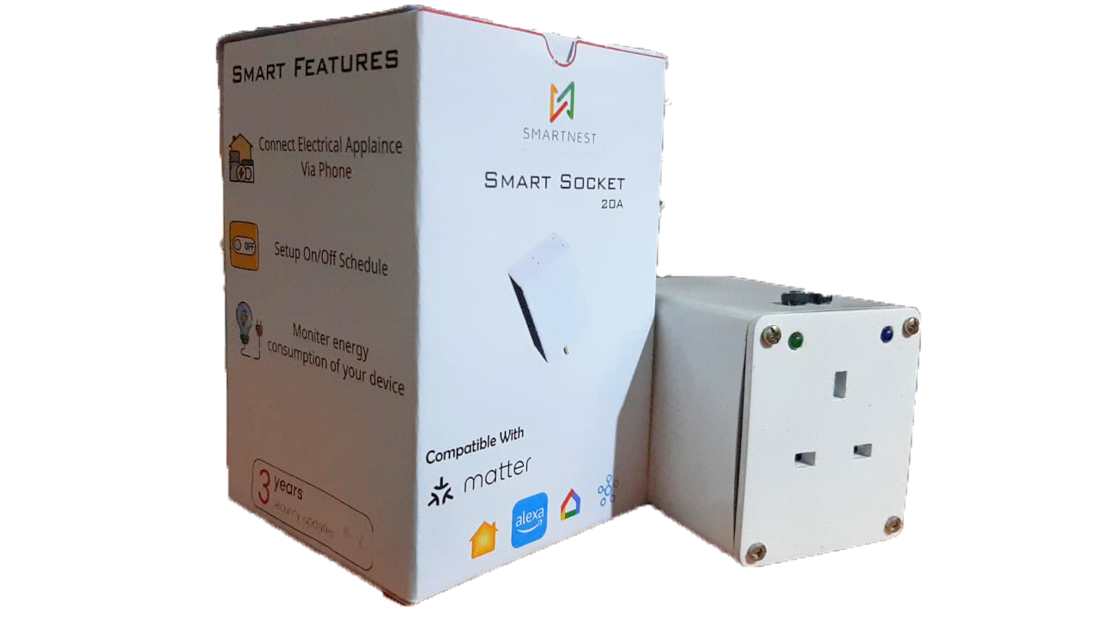
Product Launch Presentation
Introduction
This innovative device empowers you to control your appliances with effortless ease, using two powerful methods:
Download our intuitive app and enjoy the freedom of remote control from your smartphone or tablet.
Our smart plug seamlessly integrates with popular Matter-supported platforms like Amazon Alexa, Google Home, Apple HomeKit, and Samsung SmartThings.
It also boasts integrated energy monitoring
02

Slide 4

Product Launch Presentation
Design Inspiration & Market Research
In today's world, energy conservation is a top priority.
With rising electricity costs, both homes and industries are increasingly seeking solutions to monitor their energy consumption.
This growing demand inspired us to develop a smart plug that goes beyond just control.
Market Research:
Best smart plugs with similar features (as to www.engadget.com - Best Smart Plugs in 2024) can cost upto Rs. 60,000 after shipping and taxes.
Our design prioritizes affordability while retaining key functionalities
Most of the commercial smart sockets do not have all the features as our smart socket.
.
03

Slide 5
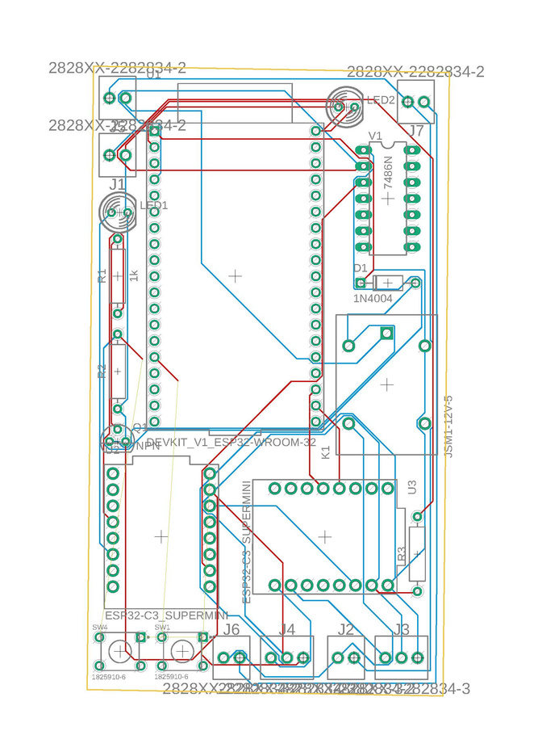
Product Launch Presentation
Smart Plug Design
We used ESP32 C3 super mini microcontroller for efficient Wi-Fi connectivity.
The integrated Atmega 328p microcontroller empowers our design with accurate energy monitoring capabilities.
The casing is crafted through 3D printing.
Portable, compact size, making it effortlessly adaptable to any space in your home.
04

Slide 6
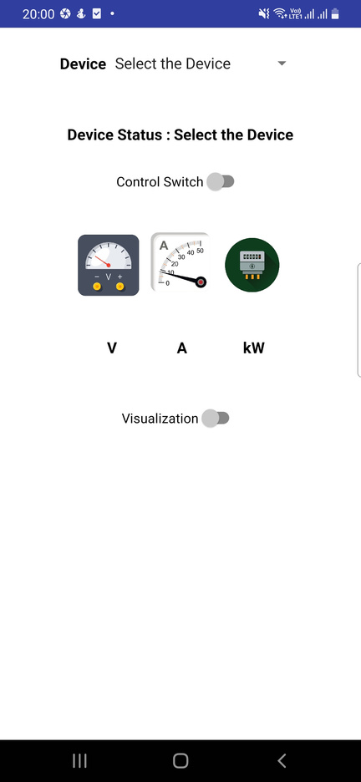

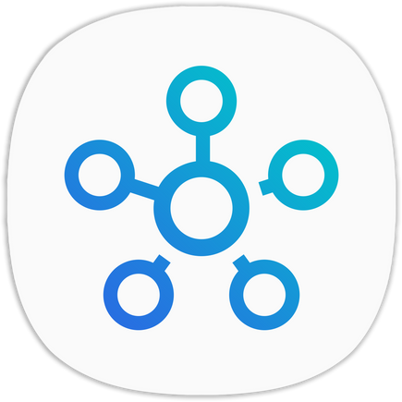


Product Launch Presentation
Functionality & Technical Specifications
Smart Control at Your Fingertips: I "Smart Nest" app, is the dedicated hub for econtrol socket and monitor energy usage.
Seamless Ecosystem Integration: Integrates with Matter-supported platforms like Amazon Alexa, Google Home, Apple HomeKit, and Samsung SmartThings. Can enjoy the flexibility of voice commands.
Data-Driven Efficiency: Track your appliance usage in real-time through the app's integrated energy monitoring system.
05

Slide 7
Budget For Smart Nest smart socket | Budget For Smart Nest smart socket | Budget For Smart Nest smart socket
Item | Quantity | Total Price (LKR)
ESP32 C3 Mini | 2 | 1750
JCL PCB | 5 | 600
3D print | 1 | 3800
Voltage Sensor | 1 | 450
Current Sensor | 1 | 640
AC to DC Converter | 2 | 700
atmega | 1 | 990
Full Electronic device set | 1 | 1354
Total Cost = LKR 10 284 | Total Cost = LKR 10 284 | Total Cost = LKR 10 284
Cost Analysis
07

Slide 8

Product Launch Presentation
Thank You

